Slide 1
Ultima 2.0
Drake Wood – James Geigerich

Slide 2
Semaphore.h - Mutual exclusion
Protects resources
Binary semaphore
Uses Queue template class
Blocked processes wait in queue
Multiple semaphores for different resources

Slide 3
Scheduler.h – Round Robin
Provides control over processes
States and info held in TCB – task control block
Template Queue of TCBs
Running, Ready, Blocked
Self yielding

Slide 4
IPC.h – Inter Process Communication
Facilitate message passing between processes
Send and receive
Mailbox functionality

Slide 5
Memory.h – Memory Management
Uses an array as a memory space
Allocates memory for processes upon request
Reads and writes
Cleanup

Slide 6
UFS.h – Ultima File System
1 file for data split into blocks
Inodes contain all of the information about the file
Inodes are contained in another file
Name|ID|StartBlock|Size|Permissions|Blocks

Slide 7
Queue.h – Template Queue
Provides the base used for classes
Linked list
Dequeue is used to cycle nodes within other classes

Slide 8
Window.h – User Interface
Hosts all interaction with the screen
Tasks and UI processes run window functions
Windows are created in the main and passed where they a are needed
UI thread is a loop that checks for input

Slide 9
Ultima OS layers
Ncurses – Pthreads
Queue Template
Sheduler – Window
Semaphores
IPC – Memory Management – File system

Slide 10
Data Flow

Slide 11
Data Structures
TCB – Task Control Block
File System
Inode
Memory

Slide 12
Test Scenarios
Phase 1 – Semaphore and Scheduler
Phase 2 – Inter-process Communication
Phase 3 – Memory Management
Phase 4 – File system
Integration Testing

Slide 13
Phase 1 Testcase ‘1’’2’’3’’r’
General operation of Ultima
Cases 1,2, and 3 kill the specific task
R induces deadlock by calling a semaphore

Slide 14
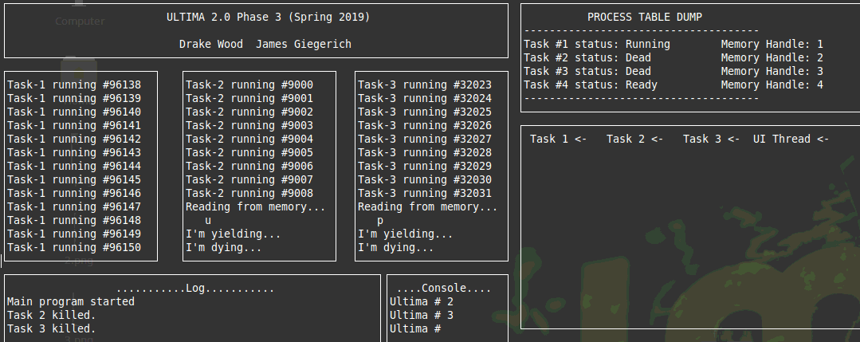

Slide 15
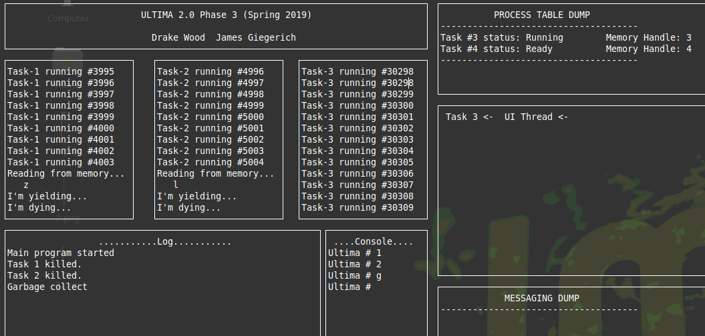

Slide 16
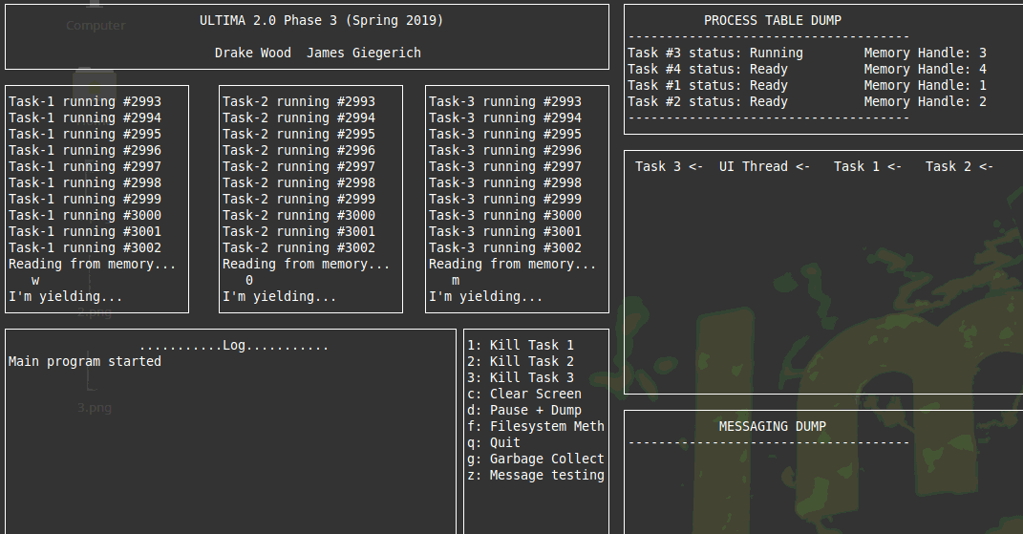

Slide 17
Phase 2 Testcase ‘z’
Print messages in task1 box
Print # of messages in task1 box
Print # of messages in all boxes
Delete messages in task1 box
Print # of messages in task1 box
Print # of messages in all boxes

Slide 18
Phase 2 Testcase ‘z’
IPC.Message_Print(1, messwin); // print messages
sprintf(buff, " # of messages in task1 box = %d \n" , IPC.Message_Count(1));
write_window(messwin, buff);
sprintf(buff, " # of messages in all boxes = %d \n" , IPC.Message_Count());
write_window(messwin, buff);
sprintf(buff, " Deleting messages in task 1 box \n");
write_window(messwin, buff);
IPC.Message_DeleteAll(1);
sprintf(buff, " # of messages in task1 box = %d \n" , IPC.Message_Count(1));
write_window(messwin, buff);
sprintf(buff, " # of messages in all boxes = %d \n" , IPC.Message_Count());
write_window(messwin, buff);

Slide 19
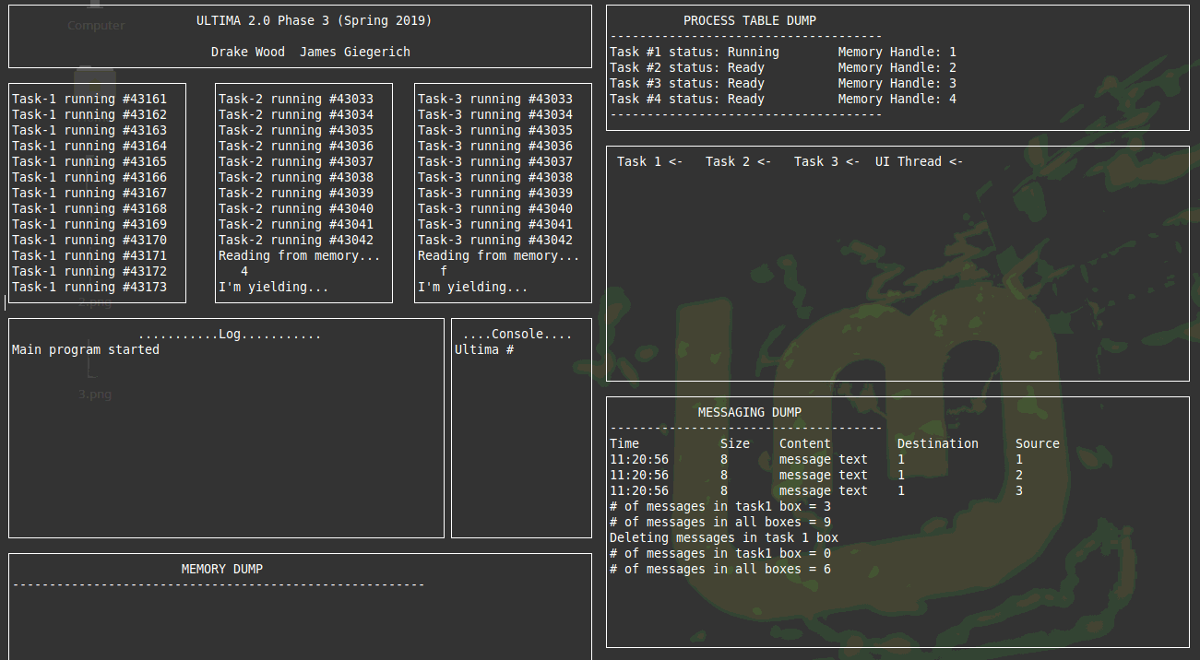

Slide 20
Phase 3 Testcase ‘m’
Dump Core
Print largest, smallest, left
Print mem usage
Overloaded memwrite
Dump Core

Slide 21
Phase 3 Testcase ‘m’
Mem_Mgr.Core_Dump(memwin);
write_window(logwin, " Calling Core_Dump()\n");
write_window(logwin, " Printing memory data: \n");
sprintf(buff, " memory largest: %d smallest: %d left: %d \n", Mem_Mgr.Mem_Largest(), Mem_Mgr.Mem_Smallest(), Mem_Mgr.Mem_Left());
write_window(logwin, buff);
write_window(logwin, " Calling Mem_Usage()\n");
Mem_Mgr.Mem_Usage(memwin);
write_window(logwin, " Calling Overloaded Mem_Write\n");
Mem_Mgr.Mem_Write(tcb->memhandle, 9, textsize, text);
write_window(logwin, " Another call to Core_Dump()\n");
Mem_Mgr.Core_Dump(memwin);

Slide 22
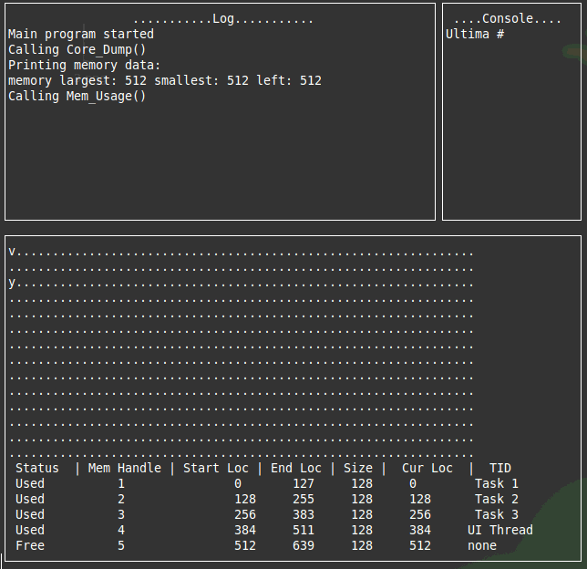

Slide 23
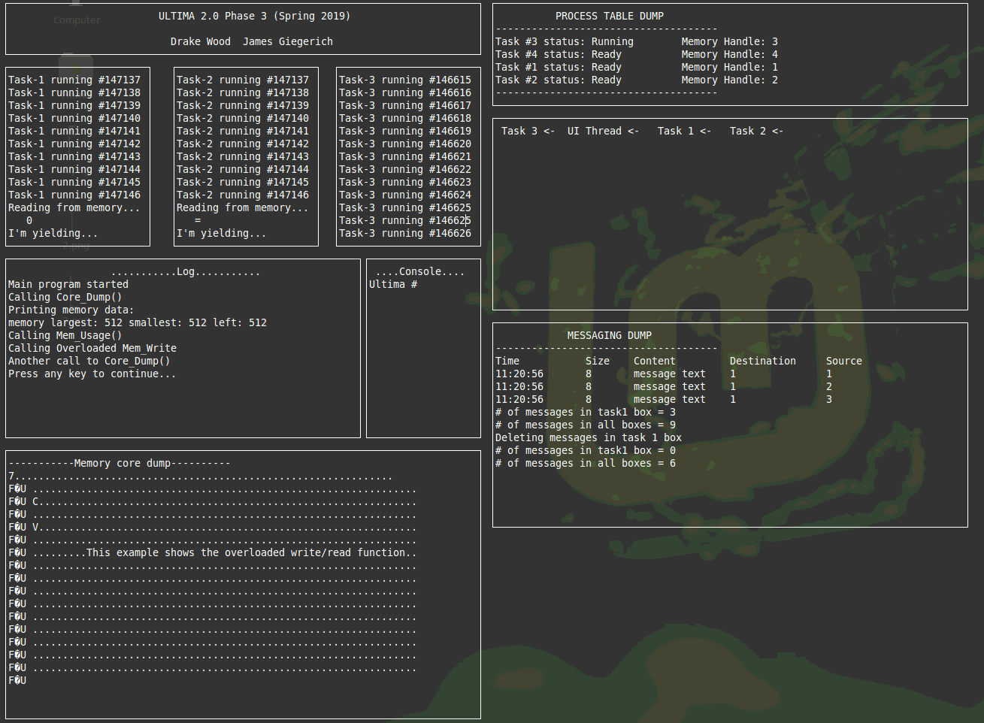

Slide 24
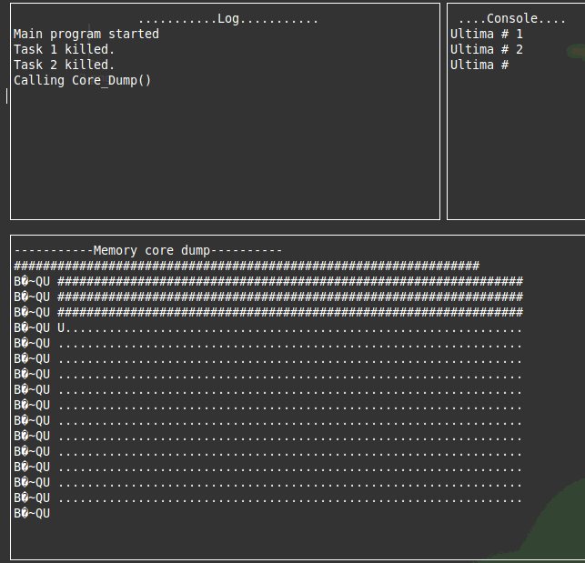

Slide 25
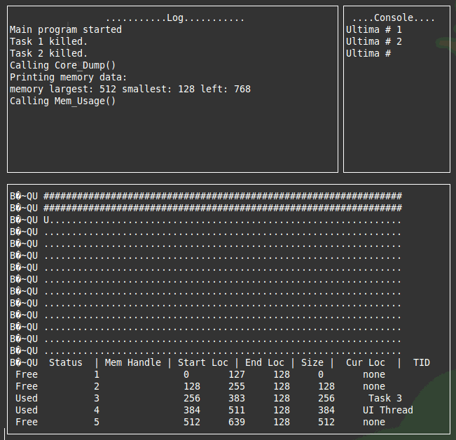

Slide 26
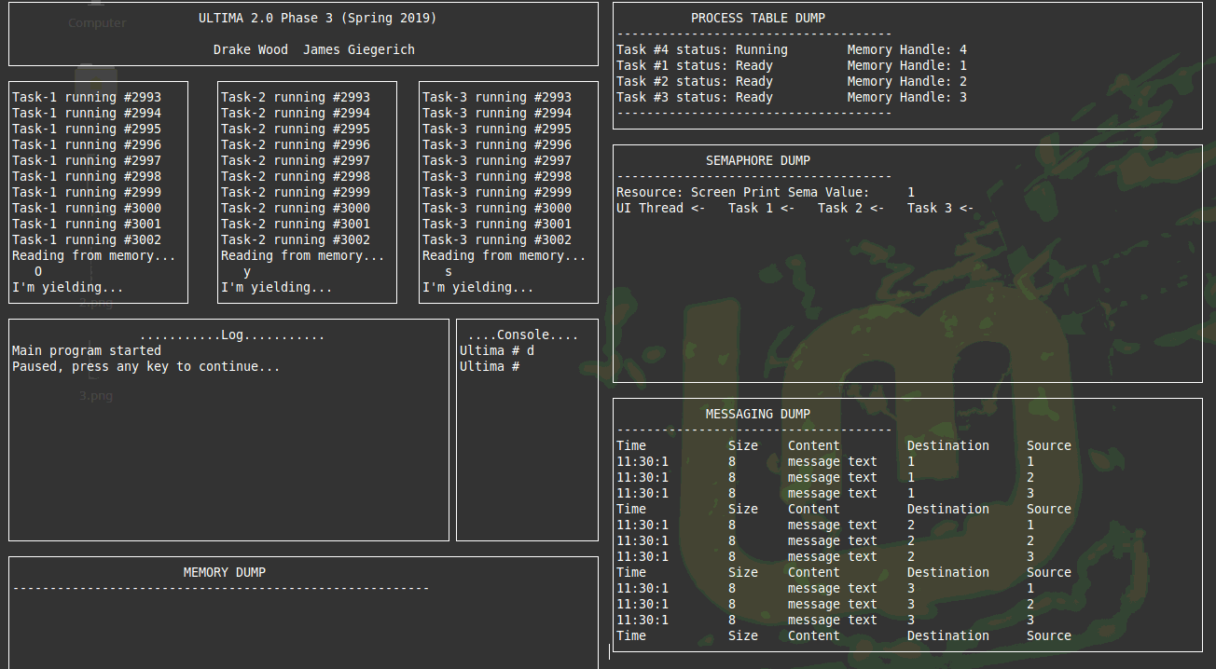

Slide 27
Phase 4 Testcase ‘f’
Print Dir
Create file with permissions 1100
Open
Write char and print Dir
Change permissions to 1111 and print Dir
Dump
Read and print
Delete file and print Dir
Dump

Slide 28
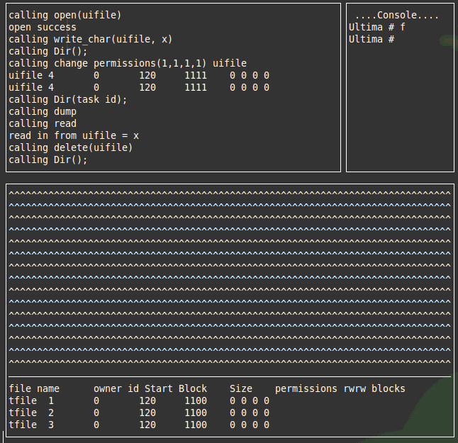
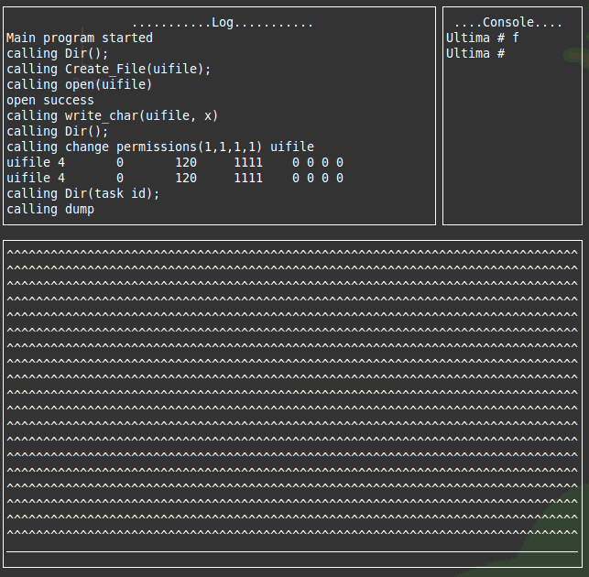

Slide 29
Phase 4 Testcase ‘f’
write_window(conwin, "f \n Ultima # ");
write_window(logwin, " calling Dir();\n" );
superuser.Dir(memwin);
write_window(logwin, " calling Create_File(uifile);\n" );
int per[4] = {1, 1, 0, 0};
superuser.Create_file(tcb->thread_no, (char*)"uifile", 120, per);
write_window(logwin, " calling open(uifile)\n" );
if (superuser.Open(tcb->thread_no, tcb->thread_no,(char*)"uifile",(char*)"w")){
write_window(logwin, " open success\n" );
}else{
write_window(logwin, " open fail\n" );
}
write_window(logwin, " calling write_char(uifile, x)\n" );
superuser.Write_Char(tcb->thread_no, (char*)"uifile", (char*)"x");
write_window(logwin, " calling Dir();\n" );
superuser.Dir(memwin);
int perm[4] = { 1, 1, 1, 1 };
write_window(logwin, " calling change permissions(1,1,1,1) uifile\n" );

Slide 30
Phase 4 Testcase ‘f’
superuser.Change_Permission(tcb->thread_no, (char*)"uifile", perm, logwin);
write_window(logwin, " calling Dir(task id);\n" );
superuser.Dir(tcb->thread_no,memwin);
write_window(logwin, " calling dump\n" );
superuser.dump(memwin);
write_window(logwin, " calling read\n" );
char v;
superuser.Read_Char(tcb->thread_no, (char*) "uifile", &v);
char buffread[256];
sprintf(buff, " read in from uifile = %c \n", v);
write_window(logwin, buff );
write_window(logwin, " calling delete(uifile)\n" );
superuser.Del_file(tcb->thread_no, (char*)"uifile");
write_window(logwin, " calling Dir();\n" );
superuser.Dir(memwin);
write_window(logwin, " calling dump\n" );
superuser.dump(memwin);

